Slide 1
CrimeCast: Forecasting Crime Categories
Niteen Kumar, Pratham Mittal, Sachin Maurya, Satyam
Group no. : 41
ML - end sem project

Slide 2
Motivation
CrimeCast is a ML project aimed at predicting crime categories based on comprehensive data, including date, time, location, and victim demographics.
Identify patterns within the data to classify the crimes into different categories like Property Crimes, Violent Crimes, Crimes against Persons etc.
Enhance proactive resource allocation and improve public safety by forecasting crime trends and preventing criminal activities. This enables the police department to identify and activate the appropriate units to address specific crime situations effectively.

Slide 3
How did we think about this?
The surge in frequency and complexity of criminal activities in India necessitates advanced solutions beyond traditional methods. Additionally, the police department often fails to respond actively to crime scenes, resulting in damaged evidence.
Drawing inspiration from the Netflix series "True Detective," which showcases the use of data and investigative techniques to solve complex crimes
Utilizing machine learning models such as Random Forest, XGBoost we can provide actionable insights to law enforcement agencies.
Our aim to create a safer community through intelligent and data-driven policing strategies.

Slide 4
Literature review Paper – 1
Title and Author : The SKALA Approach of the State Office for Criminal Investigation of North Rhine-Westphalia by (Kai Seidensticker, Katharina Schwarz (2022))
Objective : To utilize predictive policing, risk terrain modelling, and time series analysis to forecast crime categories and enhance police strategic planning in North Rhine-Westphalia.
Key Findings: The study implemented various models, including predictive policing with decision trees and random forests, risk terrain modelling, and time series analysis (ARIMA). Random forest models were particularly effective in identifying spatial crime patterns and predicting crime hotspots.
Model Relevance : CrimeCast aims to predict crime categories using similar ML techniques and data-driven approaches as highlighted in the SKALA. Incorporating random forest models that enhance our ability to identify crime patterns.

Slide 5
Literature review Paper – 2
Title and Author : “Crime forecasting: a machine learning and computer vision approach to crime prediction and prevention” (Neil Shah, Nandish Bhagat, and Manan Shah)
Objective : To explore and implement machine learning (ML) and computer vision techniques for crime prediction and prevention, aiming to improve the accuracy and efficiency of law enforcement efforts.
Key Findings: The study employed various ML algorithms, including K-nearest neighbor (KNN), decision trees, and deep neural networks (DNN). The DNN model, which integrated multi-modal data from several domains, achieved an accuracy of 84.25% in predicting crime occurrences.
Model Relevance : CrimeCast aims similar ML techniques, such as decision trees, as demonstrated in this study. By adopting these proven methods to improve our model to categories crime.

Slide 6
Literature review Paper – 3
Title and Author : “Scalable high-resolution forecasting of sparse spatiotemporal events with kernel methods: a winning solution to the NIJ Real-Time Crime Forecasting Challenge“ (Seth Flaxman, Michael Chirico, Pau Pereira, Charles Loeffler)
Objective : To develop a scalable spatiotemporal event forecasting model using advanced kernel methods to predict crime hotspots and improve public safety measures.
Key Findings: The study introduced a forecasting model combining Reproducing Kernel Hilbert Space (RKHS) methods with autoregressive smoothing kernels, achieving significant accuracy improvements over baseline models. The model utilized a hybrid approach, integrating kernel density estimation (KDE) and self-exciting point process (SEPP) models with Gaussian processes for superior crime prediction.

Slide 7
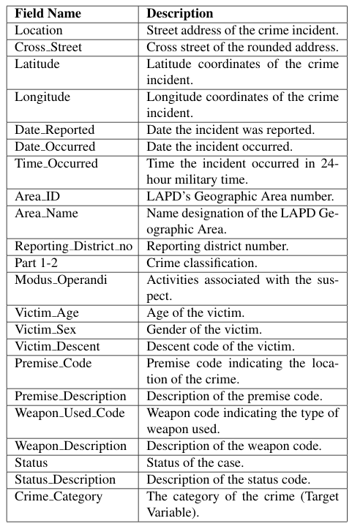
Overview of Crime Data
Geographic Coverage: Los Angeles Police Department (LAPD) jurisdictions.
Time Period: 2020 incidents.
Key Features: Location data (addresses, coordinates, LAPD areas)
Incident details (dates, times, crime categories)
Victim demographics (age, gender, descent)
Crime specifics (weapons, premises, modus operandi)
Case status and resolution information
Dataset suitable for spatial-temporal crime pattern analysis and forecasting.

Slide 8
Data Insights
Crime Categories & Patterns: Property crimes appear to be the most frequent category.
Geographic Distribution: Crimes are spread across different LAPD areas (Central, Pacific, Hollywood, etc.).
Temporal Patterns: Many incidents reported in early 2020 (January-March).
Day Patterns:
Many incidents occur during business hours
Property crimes more common in evening hours
Violent incidents show more late-night occurrences
Victim Demographics: Wide age range: from young adults (20s) to elderly (70s).
Gender Patterns:
Female victims: Higher representation in residential crimes
Male victims: More street-level incidents

Slide 9
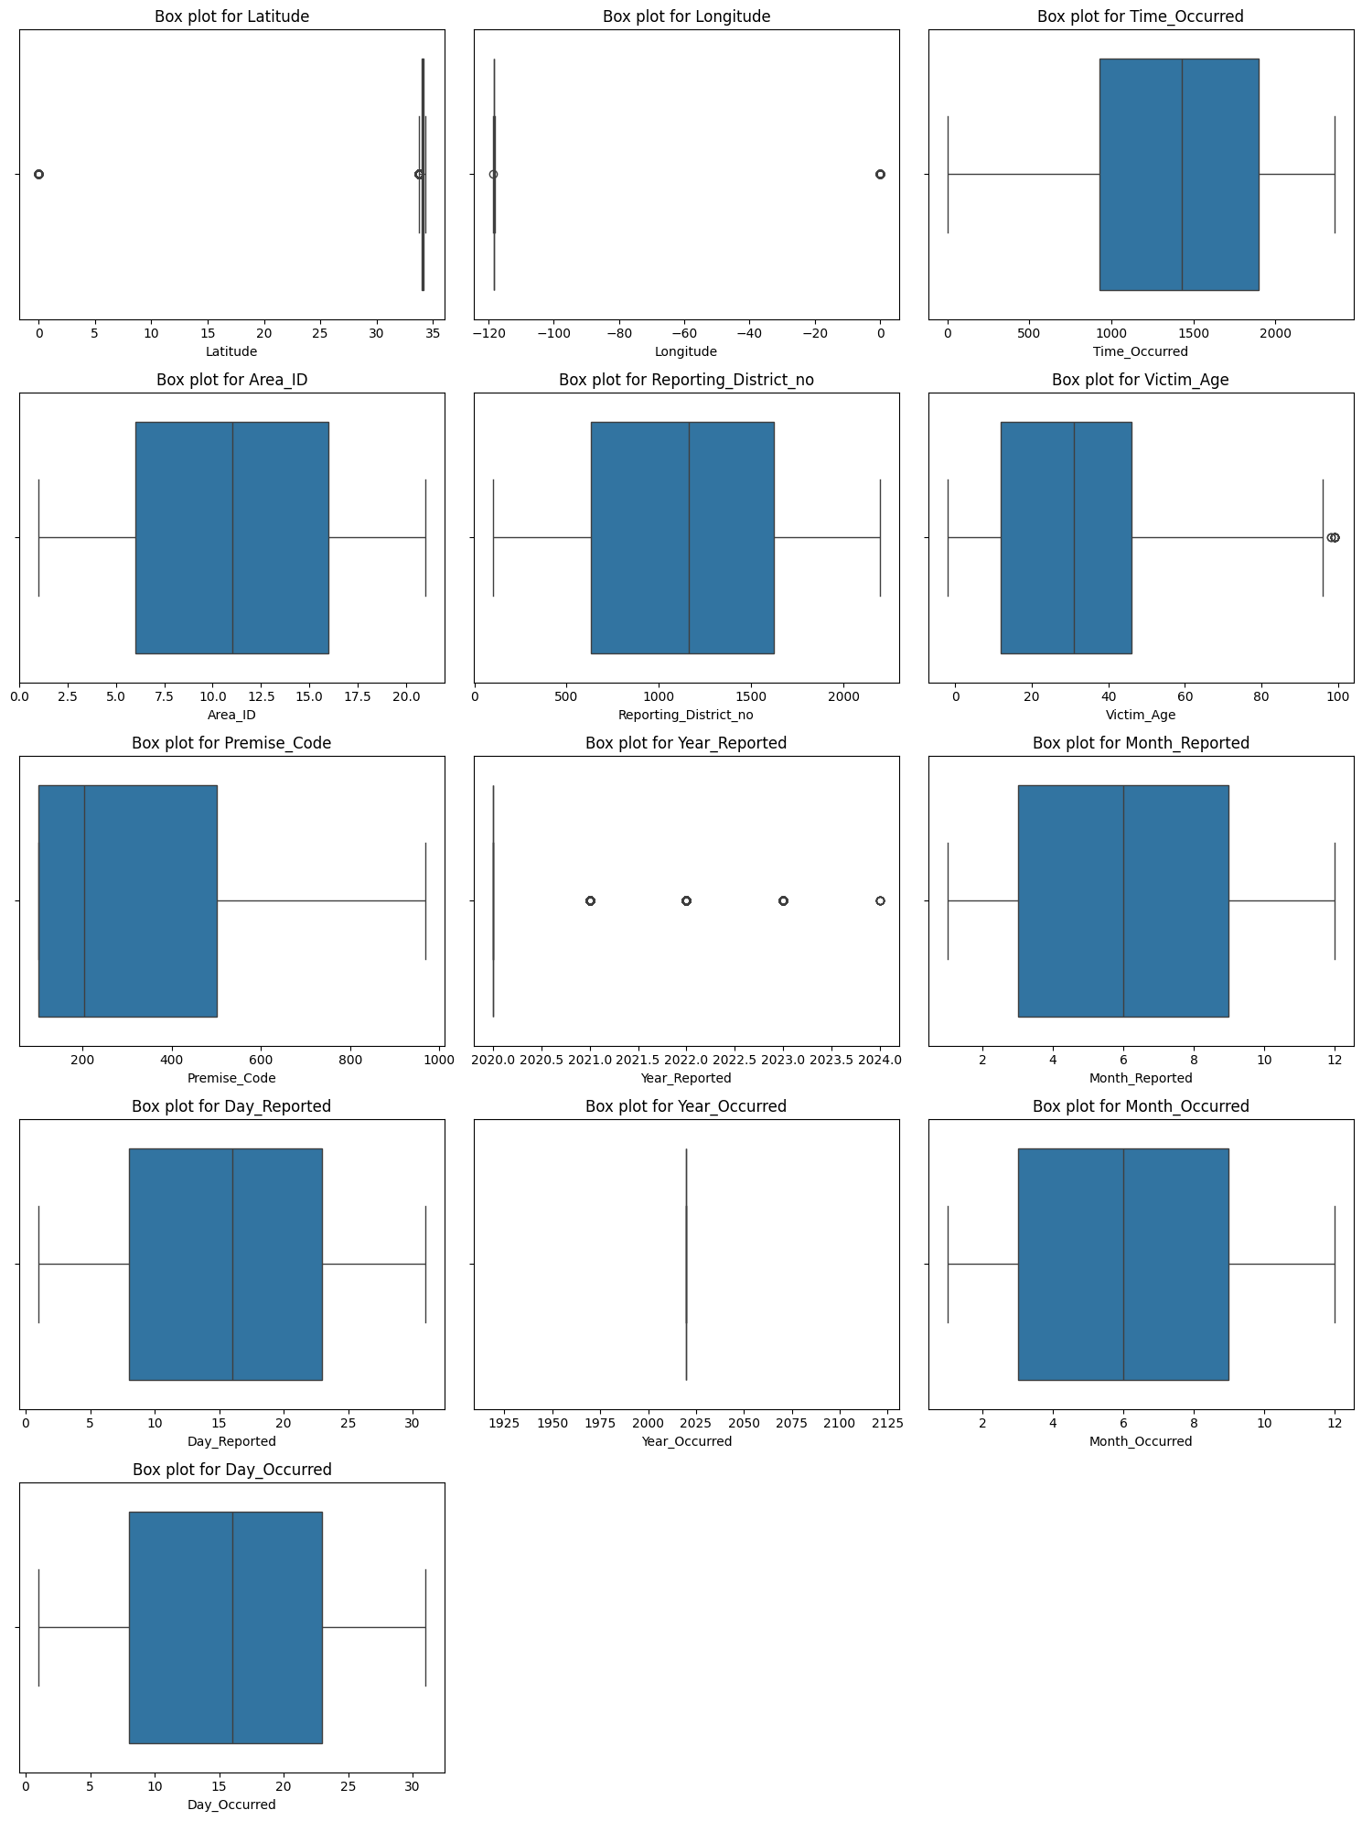
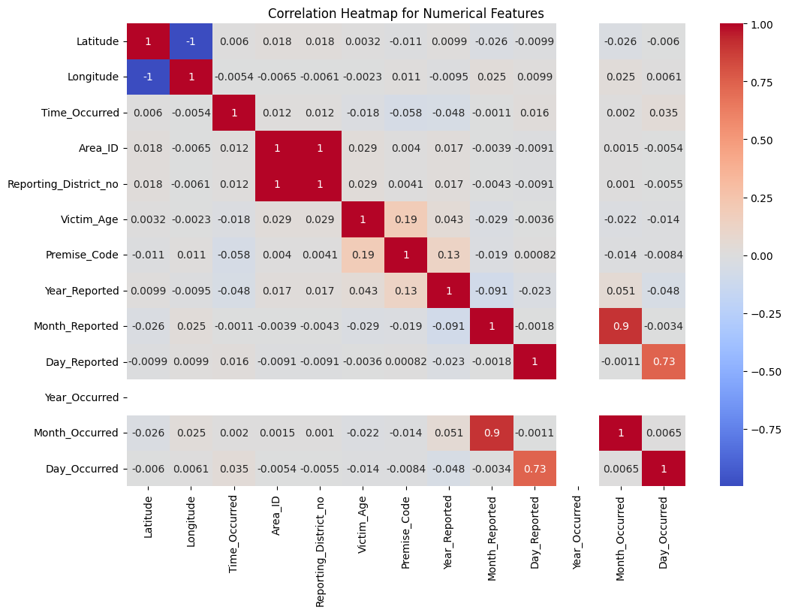
Visualization of Data
The box plot summarizes the distribution of a dataset by showing key statistics distribution, central value, spread, and presence of outliers in a dataset.
The features that contain outliers are Latitude, Longitude, Victim_Age, and Year_Reported.
These points are significantly far from the rest of the data points.
The heat map helps us for visualizing patterns, relationships, and correlations within a dataset by highlighting areas of importance or clustering
The features having positive correlation are Victim_Age & Premise_Code.
These variables are highly interrelated with each other.

Slide 10
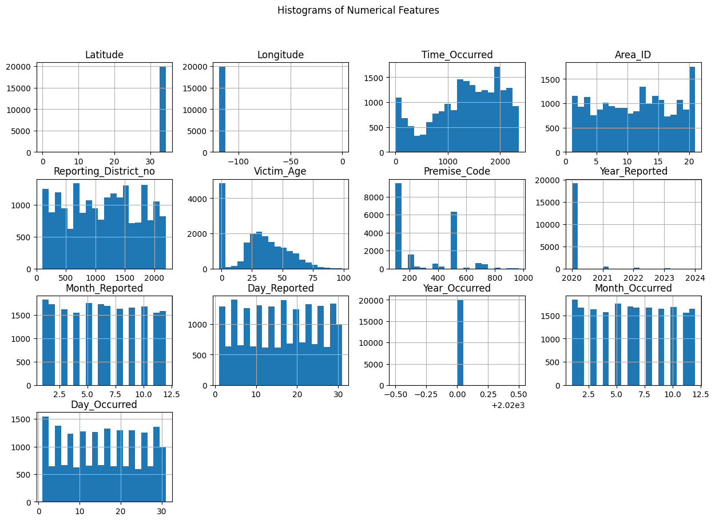
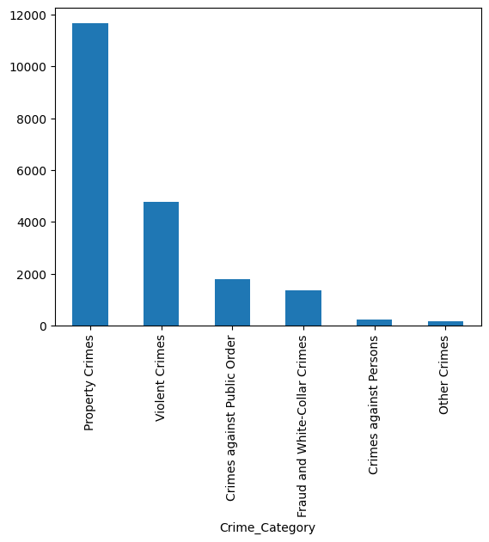
Visualization of Data
Notable patterns emerge regarding the time of occurrence.
Crime occurrence shows correlation with specific age groups, highlighting vulnerable demographics.
Certain premises (e.g., streets, residential areas) have higher crime incidences.
Property-related offenses are the most prevalent.
Personal safety is a concern, with notable violent crime rates.
Financial crimes and public order disruptions are significant but less frequent.

Slide 12
Pre Processing on Data
Feature Selection: To enhance model performance and interpretability by selecting the most relevant features while removing unnecessary columns (e.g. Cross_Street)
Removing Outliers : Eliminated outliers when determined to be errors or extreme cases that skew the analysis (e.g. Victim_Age and Latitude/Longitude of Crime place)
Missing Values: Identified and addressed missing entries in critical fields (e.g., Victim Age, Weapon Used) using techniques like imputation or removal.
Encoding Categorical Variables: Converted categorical fields (e.g. Area_Name, Status) into numerical formats using one-hot encoding or label encoding to facilitate model training.
Creation of New Features: Developed additional variables (e.g. Date_Reported) to enhance analysis depth and predictive modelling.
Training and Testing Sets: Divided the dataset into training and testing subsets (e.g., 80/20 split) to evaluate model performance effectively.

Slide 13
Methodology
Data Preprocessing: Includes data cleaning, outliers detection and handling and feature selection.
EDA: Using different plots like pair plot, box plot, count plot and heat map etc for data analysis.
Handling Categorical Data: Perform one hot encoding for all categorical feature and label encoding for target columns.
Machine Learning Algorithms: Implemented machine learning models including Naive Bayes, Random Forest, XGBoost, SVM, and MLP to enhance predictive accuracy and classification performance.

Slide 14
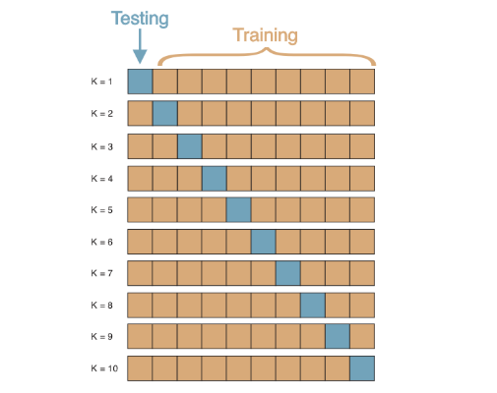
Methodology
Metrics Used: Accuracy, precision, recall, and F1-score to assess model performance.
Cross-Validation: Employed 10-fold cross-validation to ensure model robustness and prevent overfitting. This rigorous validation technique helped in selecting the most robust and generalizable model, ensuring that the results were not dependent on a particular train-test split.

Slide 15
Results
The k fold cross-validation results for the models indicates for k=10 as:
Naive Bais: significantly lower mean accuracy of 33.90%, with a mean precision of 79.00%, a mean recall of 34.00%, and a mean F1 score of 42.00%.
Random Forest: achieved a mean accuracy of 83.55%, with a mean precision of 83.12%, a mean recall of 84.34%, and a mean F1 score of 82.47%.
XGBoost: achieved a notable accuracy of 87.10%, with a mean precision of 87.00%, a mean recall of 85.32%, and a mean F1 score of 86.88%.

Slide 16
Results
SVM: achieved a mean accuracy of 86.18%, with a mean precision of 85.68%, a mean recall of 85.45%, and a mean F1 score of 72.60%.
MLP: achieved a mean accuracy of 86.10%, with a mean precision of 85.00%, a mean recall of 86.17%, and a mean F1 score of 86.00%.

Slide 17
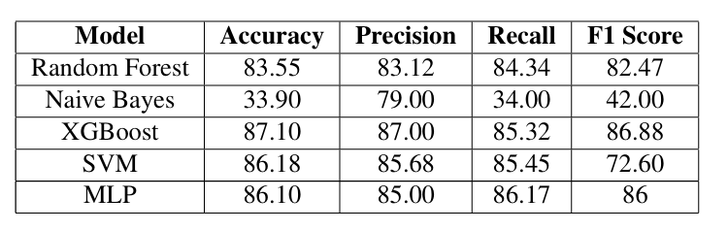

Results:
XGBoost demonstrated superior performance across all metrics, making it the most effective model for crime category.
Random Forest also performed well, significantly better than Naive Bayes.

Slide 18
Results:
Naive Bayes struggled, indicating its assumptions may not hold true for this dataset.
SVM achieved high accuracy and precision, making it a reliable model for crime category prediction. However, its F1 score was slightly lower compared to XGBoost.
MLP also showed strong performance with high accuracy, precision, and recall, making it a competitive model for crime category prediction.

Slide 19
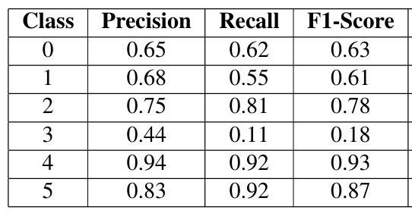
Class wise accuracy using xgboost:
Class 4 achieves the highest precision, making it the most reliably predicted class by XGBoost.
Class 3 has the lowest precision, indicating difficulty in accurately predicting this class.
Overall, XGBoost performs well for most classes, particularly for Class 4 and Class 5, but struggles with Class 3.

Slide 20
Timeline
Completed Tasks:
Data collection, preprocessing, and feature identification.
Exploratory data analysis (EDA).
Model selection, training, and initial evaluation.
Model optimization and final evaluation.
Feedback integration.
Project report and presentation.

Slide 21
Individual team members’ contributions
Sachin: Data collection, preprocessing, feature identification, documentation
Niteen: EDA, feature engineering and optimization
Pratham: Model selection, training, initial evaluation.
Satyam: Model selection ,optimization, final evaluation

Slide 22
Thank You

